Slide 1

SG ScamWISE
Module 10:
Digital Parenting/ Mentorship

Slide 2




Today’s objective
Segment 1
Arm ourselves as informed parents of Digital Natives
Digital management
Age-based recommendations
Youth-targeted scams
Current & Emerging
Cyberbullying
Victim & Perpetrator
Segment 2
Train other parents with our knowledge
Trainer toolkit
Raising awareness

Slide 3


In your group…
Introduce yourself
How many children & children’s age
Your biggest concern as a Digital Native parent.
Notes:
Note to trainer: Use whichever slide fits the presentation format – in-person/online

Slide 4
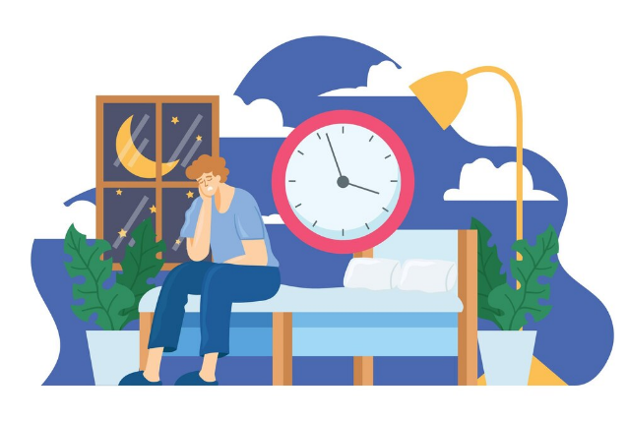
What are parents concerned with?
Notes:
Ask a few parents to share a summary of concerns from their table

Slide 5
Negative influence on children’s behaviour, attitudes and social skills
Inappropriate content
Long term unknown effects on health & development
Safety and privacy
Excessive time on social media
Source: Agosto et al., 2024
Notes:
Set the stage for the next slide i.e. different age groups face threats differently as their online behaviour evolves as they grow
Further readying: Agosto, D. E., Abbas, J. M., Feng, Y., Salib, G., Cox, E. D., & Munyao, M. M. (2024). “we were beaten down”: Parents’ concerns about children’s digital media use. Proceedings of the Association for Information Science and Technology, 61(1), 1–12. https://doi.org/10.1002/pra2.1003

Slide 6






Approach to Attitudes
Social Media Attitudes
Parenting Approach
Structure & Co-Play
Set controls
Involved
Primary School
Developing Skills
Trust & Boundaries
Set ground rules
Participate
Early Teens
Connecting & Creating
Late Teens
Branching Out
Dialogue & Privacy
Set expectations
Respect personal space
Source: Children & Parents - Media Usage and Consumption 2023, OFCOM
Notes:
Hand icons to help with recall. The hand gradually lets go (hand hold, clap, high-five).
Inform parents to keep these in mind, especially the attitudes & approach relevant to their children’s age groups
https://www.ofcom.org.uk/siteassets/resources/documents/research-and-data/media-literacy-research/children/childrens-media-use-and-attitudes-2023/childrens-media-use-and-attitudes-report-2023.pdf?v=329412#:~:text=Apps%20and%20sites%20used%20by%20children&text=This%20is%20not%20surprising%2C%20considering,illustrated%20in%20the%20figure%20below.&text=children%20with%20profiles%20on%20YouTube,%2D17%2Dyear%2Dolds.

Slide 7

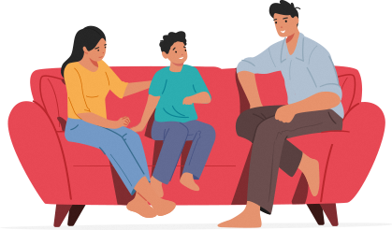
Parenting for Wellness
Establishing Family Rules and
Decisions Together
Creating family rules is a discussion between you and your child.
Set rules for younger children; more flexibility and autonomy for older children.
Review and adjust rules as the child matures.
Credit: Establishing Family Rules and Decisions Together, Pg 14, PfW Toolbox for Parents
Image: Pfw-HPB
Notes:
Guidance from the Parenting for Wellness toolkit. A toolkit jointly created by MOE, HPB & MSF
Setting ground rules and controls should be discussed with the child

Slide 8


Scan to download this Parenting for Wellness Toolbox
(QR code also available on your table)
Notes:
Invite parents to scan and download the toolbox for themselves
Contains a treasure trove of good tips and tools.

Slide 9
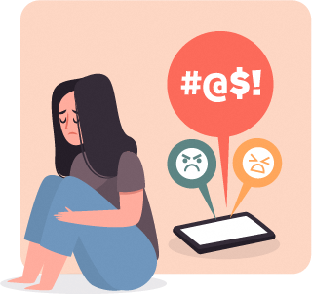
Cyberbullying
Image: Pfw-HPB

Slide 10
Do you know?
Which of the following describes Cyberbullying?
Telling a girl she is “ugly” to her face
Clarifying a rumour about a classmate with another classmate which turned viral
Reposting a meme about a classmate on your instagram account
Spreading a rumour in class about a classmate
Notes:
Don’t explain why. Move to next slide

Slide 11
Definition of Cyberbullying
Cyberbullying is bullying that occurs when online technology is used as a means to
hurt or upset someone
on purpose and repeatedly*.
*Sharing or resurfacing on a single post
is also a form of repetition.
Source: Cyberbullying: When Your Child is the Victim, Pg 55, PfW Toolbox for Parents
Notes:
Unlike the traditional definition of ‘bullying’, cyberbullying has a broader scope. Does not apply only to abusing individuals weaker than you
It’s also has a lower threshold of ‘upset’ vs ‘hurt’

Slide 12
Do you know?
Which of the following describes Cyberbullying?
Telling a girl she is “ugly” to her face
Clarifying a rumour about a classmate with another classmate which turned viral
Reposting a meme about a classmate on your instagram account
Spreading a rumour in class about a classmate
Notes:
Which is why, there could be room to argue that b and d may also be classified as cyberbullying when viral untruths are traced back to the source.

Slide 13
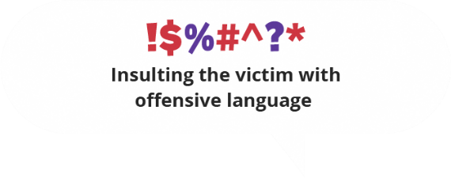
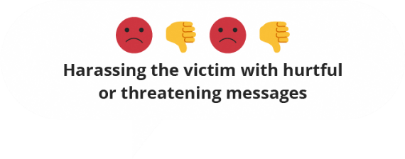
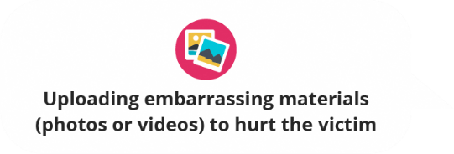


Forms of Cyberbullying
Offensive language
Harrassment
Hurtful content
Impersonation
Deliberate isolation
Image: Pfw-HPB
Notes:
Cyberbullying comes in many forms.
Explain each in the following slides

Slide 14
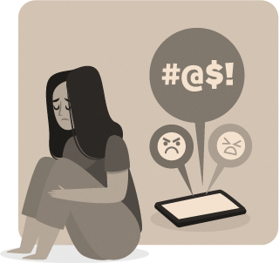

Forms of Cyberbullying
Deliberate isolation
WHAT
When your child is being intentionally removed or isolated on social media and groupchats
TAKE ACTION:
Empathise with and support your child through his/her emotions
Seek support from the school (counsellor or trusted teacher) to monitor your child
With your child’s consent, work with the school to find out the root cause for the isolation
Image: Pfw-HPB
Notes:
Before seeking external help, speak to your child and get his/her consent. He/she may have reasons for not wanting to seek external help.
Read Pfw pg 55 to 57 and use 1 or 2 points in your presentation
You may wish to read pg 27 on how to encourage the child to seek help

Slide 15
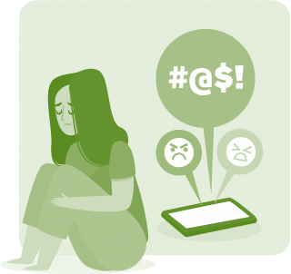

Forms of Cyberbullying
Offensive language
WHAT
When someone directs rude and offensive language at your child
TAKE ACTION:
Take a screenshot and report the incident to school authorities & the associated platform
Work with the school to find out both sides of the story
Empathise with and support your child through his/her emotions
Image: Pfw-HPB
Notes:
Read Pfw pgs 29 to 34

Slide 16

Forms of Cyberbullying
Harassment
WHAT
When someone repeatedly directs rude and offensive language at your child or stalk your child
TAKE ACTION:
Take screenshots, log the frequency, and report the incident to school authorities & the associated platform
If harassment continues, report the incident to the police
Harassment is a crime under the Protection from Harassment Act (POHA)
Image: Pfw-HPB
Notes:
Read Pfw pgs 57 on what to do when your child is a victim

Slide 17

Forms of Cyberbullying
Impersonation
WHAT
When someone creates a fake account in your child’s name to spread content that tarnishes your child’s reputation
TAKE ACTION:
Take screenshots and inform the platform service provider(s) to take down the fake accounts
Help your child to reset all passwords and online accounts
If the impersonation caused your child to be harassed, this falls under the POHA
Image: Pfw-HPB
Notes:
Read Pfw pgs 57 on what to do when your child is a victim

Slide 18

Forms of Cyberbullying
Hurtful content
WHAT
When someone shares embarrassing and/or offensive materials regarding your child, including photographic content
TAKE ACTION:
Take screenshots, and report the incident to school authorities & the associated platform
If the content is pornographic in nature, make a police report immediately
Production & distribution of porn, inc deepfake, involving minors (<16 years old) is chargeable under Section 377BH of the Penal Code
Image: Pfw-HPB
Notes:
Further reading: https://www.channelnewsasia.com/singapore/deepfake-porn-legal-action-cna-explains-4749306

Slide 19
Cyberbullying:
Victim Red Flags
Sudden changes in temperament and physical health
Socially withdrawn & disengaged
Loss of appetite & interest
A sharp decline in academic performance
Image: Pfw-HPB
Credit: Parenting for Wellness website on Parent Hub, Health Promotion Board
Notes:
Refer to pg 55 of the Parenting for Wellness guide

Slide 20
Group Discussion (8mins)
How can you support your child through the following forms of Cyberbullying?
What might your child feel in this situation?
What would be a helpful response?
Scenario 1: Deliberate isolation [Intentionally excluding the victim from an online group]
Scenario 2: Hurtful content [Uploading embarassing materials (photos or videos) to hurt the victim]
Image: Pfw-HPB
Notes:
Split the participants into 2 sides of the room and assign the groups on each side a scenario
After 8mins, ask 1 or 2 groups from each scenario to share

Slide 21
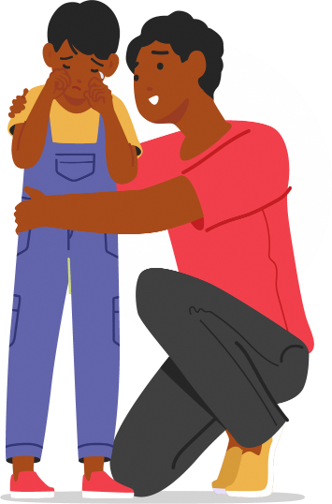
Parenting for Wellness
Cyberbullying: When Your Child is the Victim
C
Calm down.
Hear them out.
Empathise with them.
Encourage them to seek help.
Reassure them.
H
E
E
R
Image: Pfw-HPB
Credit: Cyberbullying: When Your Child is the Victim, Pg 56, PfW Toolbox for Parents
Notes:
Introduce the CHEER framework
Acknowledge the group whose points have elements of CHEER

Slide 22
Other tips
Avoid responding to the bully in the heat of the moment.
Take a break from social media.
Find a trusted friend or adult in school to be a care buddy.
Image: Pfw-HPB

Slide 23

Stop Cyberbullying
Be an upstander.
Reporting is not snitching.
When unsure, speak to a trusted adult.
Image: Pfw-HPB
Notes:
Cyberbullying should not be tolerated. It needs to be reported. It’s not good to be a bystander
Assure child that reporting is not snitching (Suggested talking point for"Reporting is not snitching"t: Your child may not want to talk about their problem if they are afraid of getting someone else into trouble, or they feel that confiding in someone may make the bullying worse. Reassure them that you only wish to have a better understanding of the situation so that you can keep them safe.)
Sometimes your child may not be certain if what he/she witnessed is cyberbullying. The child should check with a trusted adult and discuss their concerns

Slide 24

Parenting for Wellness
Cyberbullying: When your Child is the Bully
Remain calm and find out what happened and their reasons for acting in that way.
Explain to your child that bullying is unacceptable.
Explain the consequences of cyberbullying.
Impose restrictions and monitor child’s online activities.
Ask the school for support e.g. counselling, if necessary.
Credit: Cyberbullying: When Your Child is the Bully, Pg 58, PfW Toolbox for Parents
Image: Freepik
Notes:
Read Pfw pgs 58 on what to do when your child is the bully

Slide 25

Youth-targeted scams & harms
Image: Pfw-HPB

Slide 26

Parenting for Wellness
Caring for Yourself
Hold 3 (H3), Release 5 (R5)
Breathe in (H3); Breath out slowly (R5)
Tighten your fists (H3), release slowly (R5)
Breathe in (H3); Breath out slowly (R5)
Lift your shoulders (H3); relax & roll slowly (x5)
Breathe in (H3); Breath out slowly (R5)
Image: Pfw-HPB
Credit: Caring for Yourself, Pg 41, PfW Toolbox for Parents
Notes:
To ease the tension from the heavy cyberbullying topic, invite everyone to stand and do these exercises (should complete in 2mins) before diving into the next topic
As parents, we must walk the talk and take frequent breaks from being sedentary.
We must look after ourselves and keep physically and mentally fit to look after our family well.
This brief pause will energise everyone and reset their mind for the next section of learning.

Slide 27
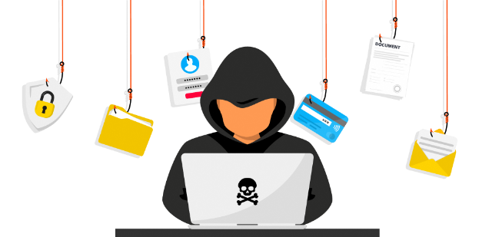
Pair and Share
Image: Pfw-HPB
Find a partner. Together, discuss the upcoming examples:
Determine if they are scam or legitimate
Explain your rationale to each other
Take note! You have 30secs to answer each puzzle.
Notes:
Ask participants to find a partner to discuss and determine if the examples are a scam or otherwise.

Slide 28

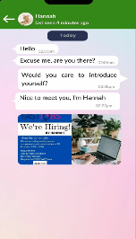


Is this a scam?
Job Offer:
Getting headhunted for a job
Hello, I’m Hannah
Are you there?
Yes
Care to introduce yourself?
Nice to meet you, I’m Hannah
No
Notes:
Scam = Texter asking you for your name. Likely a job scam.
NB: there will be complaints throughout the game that the picture isn’t clear. In our busy day-to-day, most will just take a quick look at the messages and make snap decisions. These exercises simulate how we make snap judgments. Details don’t really matter.
Objective at the end of the game: To reinforce the importance of pausing to check.

Slide 29

Is this a scam?
E-commerce deal: Get a free gift card worth $20 with a min spend
Yes
No
Notes:
Not scam = Free $20 gift card is reasonable. Logo and promo logo are correct. Even so, open your own Shopee account instead of using this .

Slide 30

Is this a scam?
Shopping Offer:
Limited edition shoes at 90% discount
Yes
No
Notes:
Scam = 90% discount is too good to be true

Slide 31
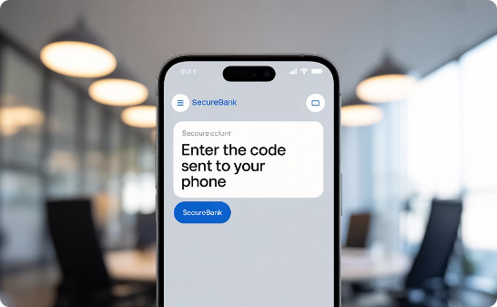
Is this a scam?
Reward: A pair of Tailor Swift tickets from your bank
Yes
You have a pair of tickets to Tailor Swift concert.
Redeem
No
Notes:
Scam = While your bank might reward you with a gift now and then, this is scam, this reward is too good to be true. And Taylor Swift is misspelt as Tailor Swift.

Slide 32
Is this a scam?
Gaming Rewards:
Get free Robux for completing survey
Yes
No
Notes:
Scam = Phishing for your personal data.

Slide 33



Age-based scams & harms
Late Teens
Early Teens
Primary School
Rewards
Games
Games
Games
Friends
Game chats
Social Media
Game chats
Social Media
Game chats
Deals
E-commerce
Social Media
Game chats
Credit: White Byte
Notes:
The 5 examples in the earlier scam quiz are simple scams.
These 2 slides include more complex scams & show different tactics to hook different age segments
Scammers could use Rewards, Friends and Deals as the scam hook
The grey bars are the primary phishing medium
NB: This is a non-exhaustive list. Next slide shows the objective of these scams

Slide 34
Age-based scams & harms
Late Teens
Early Teens
Primary School
Identity
Personal & family Data
Bank details
Family data
Family data
Privacy
Romance scam
Sexting/Sextortion
Grooming
Sexting/Sextortion
Grooming
Child porn
Money
E-commerce scam
Tickets scam
Money mule
Credit: White Byte
Notes:
The 5 examples in the earlier scam quiz are simple scams.
These 2 slides include more complex scams & show different tactics to hook different age segments
Scammers could use Rewards, Friends and Deals as the scam hook
The grey bars are the primary phishing medium
NB: This is a non-exhaustive list. Next slide shows the objective of these scams

Slide 35


Tips from National Crime Prevention Council (NCPC)
NCPC ACT campaign
ADD the Scamshield app
CHECK for scams signs with official sources
TELL families, friends and authorities about scams
Download the scamshield app
scamshield.gov.sg
Credit: National Crime Prevention Council
Notes:
Explain ACT
An example of what other gov agencies are doing to fight scams.
Encourage to download scamshield, an app jointly created by MHA, SPF, NCPC
Scamshield filters and blocks potential scam calls and SMSes. Also makes reporting scams easier and faster.

Slide 36
Common red flags
Behind the screen, not everything is what they claim to be
Too good to be true
Minor alterations to logo or branding elements
Spelling errors
Unreasonable / Illogical requests
Quick friends
High praise
Image: PfW-HPB
Credit: White Byte
Notes:
Lower scam risk by following the PC4 approach

Slide 37

Avoiding scams & harms
Behind the screen, not everything is what they claim to be
Privacy: Protect your identity
Cherish: your body and privacy
Careful: Be careful when making friends online
Check: Check before you click. If possible, avoid clicking on links.
Credible: Buy from credible sellers with high ratings and good reviews
Credit: White Byte
Notes:
Lower scam risk by following the PC4 approach

Slide 38




Useful Numbers
Call the following for assistance if you suspect your child is facing online harm.
Agency |  | Number | Operating Hours
 | Singapore Police Force | 1800 255 0000 | 24 hours
 | Samaritans of Singapore (SOS) | 1767 WhatsApp: 9151 1767 | 24 hours
 | Sg Her Empowerment (SHE) | 800 101 4616 WhatsApp: 6571 4400 | 9am - 9pm Mondays to Fridays
 | Tinkle Friend (for children 7 to 12 years old) | 1800 2744 788 | 2.30pm - 5pm Mondays to Fridays
 | Help123 | 1800-6123 123 Email: hello@help123.sg | 9am - 6pm Mondays to Fridays
Contact your bank immediately to block any unauthorized transactions from your bank account.
Notes:
Read Pfw pg 39 for other helplines & resources

Slide 39
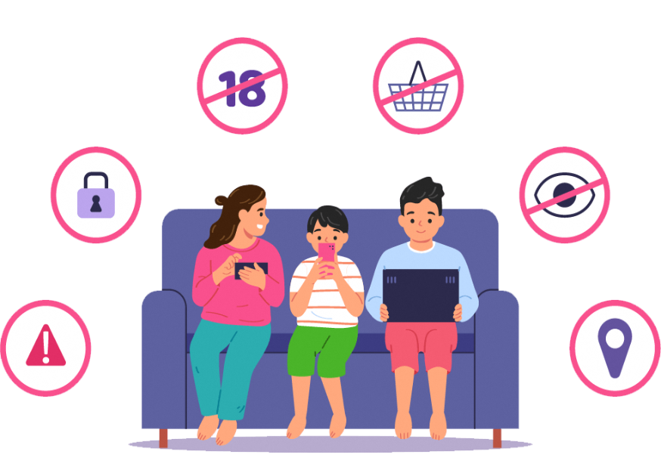
Digital Parenting
Image: Pfw-HPB

Slide 40
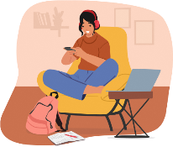

Myth: All screentime is harmful
Encourage ACTIVE Screen Use
Involves cognitive and engaging screen-based activities
Examples: Homework, edu-vid, online games, social connection
Minimise PASSIVE Screen Use
Involves sedentary viewing without thought or with little interaction
Doomscrolling, binge watching, idle chatter
Info source: MOH Screentime Guidance Pg 8 | Image: PfW-HPB

Slide 41
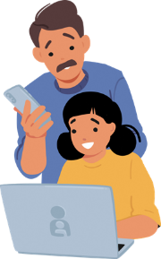
Myth: Don’t limit educational content
All content, including purportedly educational ones, must be screened according to child’s age
Not all content are of the same quality
Ascertain if content aligns to your family’s values
Certain content may not be age-appropriate
Info source: MOH Screentime Guidance Pg 3 | Image: PfW-HPB
Notes:
Although educational, some content might be too violent or inappropriate for younger children e.g. lion hunting and eating a rabbit, sexuality education
Certain content might promote themes that are acceptable in other cultures but does not resonate with your own beliefs. This might cause tension in the family especially with older teens

Slide 42



Myth: One standard approach
Age-based Parenting Approach
Age & Attitude | Approach
Primary school Developing Skills | Set controls Involve
Early Teens Creating & Connecting | Set ground rules Participate
Older Teens Branching Out | Set expectations Respect
Info source: MOH Screentime Guidance Pg 3 | Image: PfW-HPB
Notes:
Recap points from Attitude and Approach
Suggest: Hint by revealing only the pictures and ask audience/individual to call out the Attitude and Approach

Slide 43
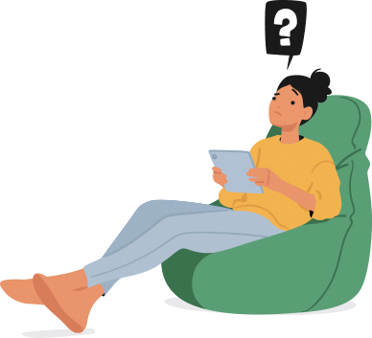
Screentime Charades
Can you guess the negative effects of excessive device use?
Image: Pfw-HPB
Notes:
Play this if there’s time.
Charade phrases: Interfere with mealtimes, insufficient sleep, anti-social behaviour
Ask one or 2 volunteers to help you with the charade.
Prepare simple prizes to motivate participation

Slide 44
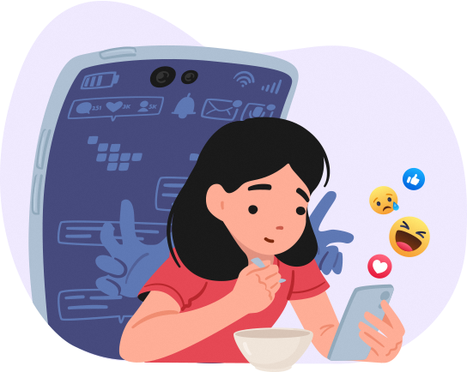
Potential Effects of Excessive Device Use
Interfere with regular mealtimes
Insufficient sleep
Anti-social behaviour
Distracted attention
Image: PfW-HPB
Notes:
Read MOH Screentime Guidance pg 2

Slide 45
Screentime Charades
How do I manage my child’s screentime?
Image: Pfw-HPB
Notes:
Ask one or 2 volunteers to help you with the charade.
Prepare simple prizes to motivate participation

Slide 46
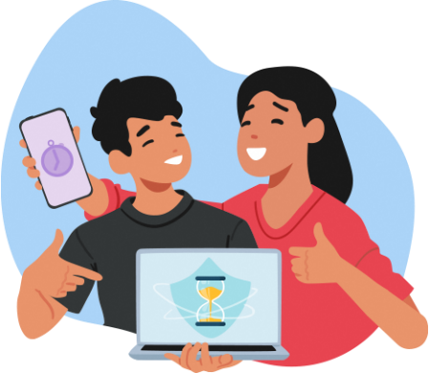
ABC of Digital Management
Agreement:
  Demonstrates trust and respect between parent-child.
Boundaries:
  Measure responsibility & accountability
Connect:
  Opportunity to connect and dialogue
Image: Pfw-HPB
Credit: White Byte
Notes:
Agreement: this is a joint process where you allow each other’s opinions to be heard. By listening to your child’s opinion, you show your trust and respect for them
Boundaries: Agreement comes with parameters. These parameters or boundaries help you see how responsible they are and reward them when they do well. They are also indicators for you to decide when to relax the boundaries and trust their judgment
Connect: The process of writing the agreement and setting boundaries is an opportunity to dialogue. Even when boundaries or overstepped, see it as a positive opportunity to dialogue and connect with your child to understand why.

Slide 47
Screentime Charades
How do I manage my child’s screentime?
Image: Pfw-HPB
Notes:
Ask one or 2 volunteers to help you with the charade.
Prepare simple prizes to motivate participation

Slide 48


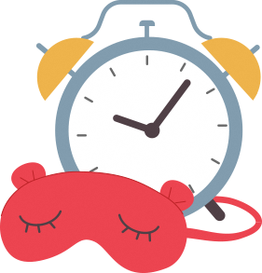
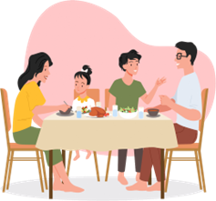


Mental, Physical & Digital Wellness Suggestions
Stop device use 1 hour before bedtime
Make housework fun
Assure, uplift & be present
Be device-free & converse during meals
Encourage & participate in non-device fun
Keep device out of reach from the bed
Notes:
Ask parents to put up their hands if they do any of these
Ask 2 or 3 to share which ones and what their experience is
Open the floor to share any other Digital Wellness tips not shown here

Slide 49
Self reflection: Do you do any of these?
Stop device use 1 hour before bedtime
Make housework fun
Assure, uplift & be present
Be device-free & converse during meals
Encourage & participate in non-device fun
Keep device out of reach from the bed
Notes:
Ask parents to put up their hands if they do any of these
Ask 2 or 3 to share which ones and what their experience is
Open the floor to share any other Digital Wellness tips not shown here

Slide 50
How do I approach screentime management?
Image: Pfw-HPB

Slide 51






Age-based Approach
Pri School¹
Early Teens²
Late Teens²
Less than 2hrs/day (excludes schoolwork)
Minimise background and passive screen use
Collaborate on a screentime plan
Involve: Guide their digital development
Jointly discuss and seek their opinion
Set ground rules for active vs passive screentime
Collaborate on a screentime framework
Participate: Explore digital content together
Jointly discuss and seek their opinion
Set expectations
Show interest and create opportunities to connect
Respect: Give personal space while assuring you are there when needed
Source: 1. MOH Screentime Guidance Pg 4 | 2. White Byte
Notes:
All screentime plans must include consequences for violating the screentime rules/plan. Enforce consequences when rules/plan is violated.
There should also be a reward component that is NOT device-related.
Treat screentime as a way of life and not as a punishment (removal) or reward (more screentime)

Slide 52

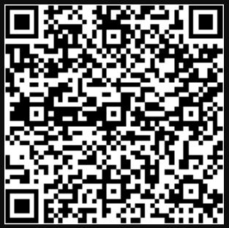
Scan to download MOH Guidance on Screen Use in Children
Up to age 12 only
(QR code also available on your table)
Notes:
Screentime Guidance up to age 12

Slide 53
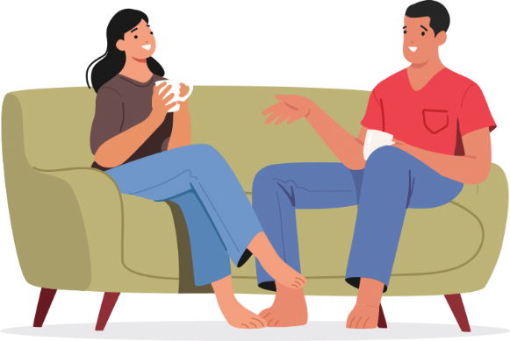
Digital Management starts with YOU!
You are the role model to good digital habits.
Image: Pfw-HPB

Slide 54
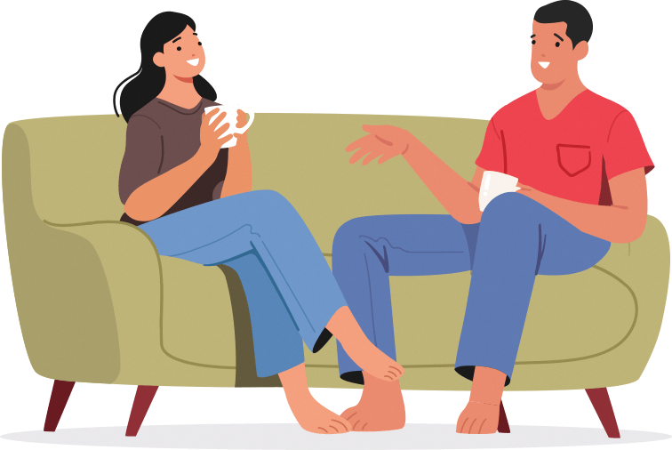
Photo Taking & 15 Min Break
Image: Pfw-HPB

Slide 55
What have we learnt?
Image: Pfw-HPB

Slide 56
What have we learnt?
Notes:
We will be learning about screentime use through a Truth or Myth game.
Form a circle with their hands for Truth and cross their hands in an X for myth (Demonstrate the action to the audience)
This is an individual game

Slide 57
Do you know?
How is cyberbullying different from traditional bullying?
It doesn’t include offensive language
It doesn’t involve violence
It can be criminalized under POHA
It is not limited to weaker individuals

Slide 58
Do you know?
Which of the following is good digital parenting?
Setting strong passwords on your devices
Adopting age-based cyber management approach
Designing a strong digital management plan by yourself
Having your own device time after the children’s bedtime

Slide 59
Do you know?
What is suspicious about this ad?
The heels are glowing
Novatech X is not a real brand
90% discount is unrealistic
All of the above

Slide 60
Do you know?
Screentime must be managed for all content except educational content.
True
False

Slide 61
Do you know?
Your daughter tells you she found hurtful online content about her. What should you do?
Quickly take a screenshot and accompany her to make a police report
Help her to draft a comment to clarify the situation
Tell her to delete the content and reset her account
Advice her to keep calm and ignore it

Slide 62
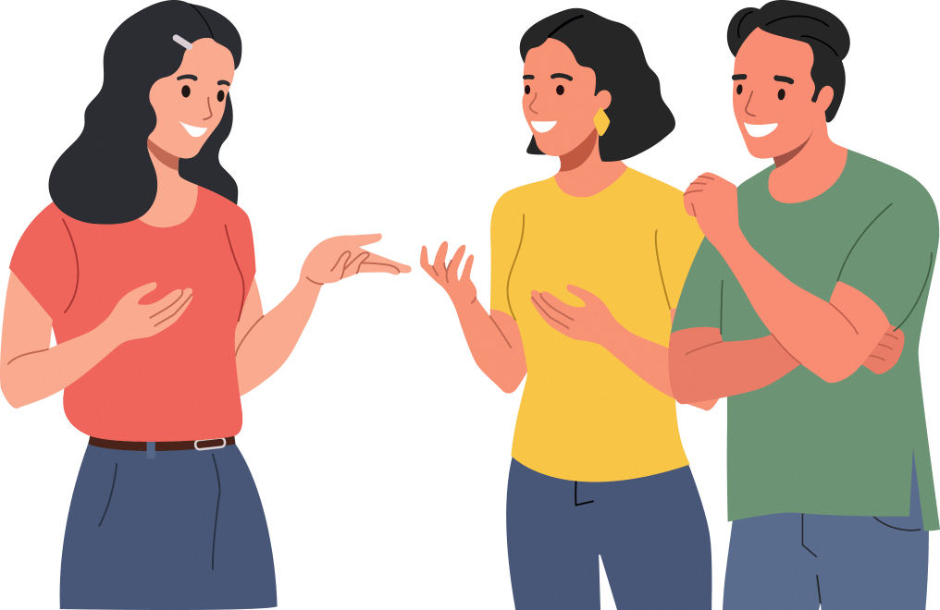
Q & A
Image: Pfw-HPB

Slide 63
Parents unite!
Image: Pfw-HPB

Slide 64
Share your Care
Share your knowledge
Multiply the safeguards for other children
Impact & guide other parents to be ambassadors for a resilient digital world.
Inspire others with your driven action to build a safer cyber space for our children.
Image: Pfw-HPB
Notes:
Encourage fellow parents to raise awareness of the topics today. Our children are safer when we build a network of collaborative parents who work together to protect them.

Slide 65

Getting started: 3As approach
Know your Audience
Identification: Who are they?
Connection: What do I have in common with them?
Motivation: Why are they here?
Image: Pfw-HPB
Notes:
Knowing these help you customize the presentation to be more relevant to the audience

Slide 66
Getting started: 3As approach
Know your Ambience
Date & time: Is it in the morning or afternoon?
Venue: What is my travelling time?
Environment: Is it fully equipped? What do I have to bring?
Image: Pfw-HPB
Notes:
More activities for afternoon session to beat the post-lunch lethargy
Allocate sufficient travelling time to the venue. Arrive about 30mins ahead to test the equipment
Find out what hardware is available so you can prepare what is missing

Slide 67
Getting started: 3As approach
Know your Arsenal
Information: What is your content?
Engagement: How will you engage the audience?
Gamification: How to increase retention?
Image: Pfw-HPB
Notes:
Segue into the next slide on Engagement & Gamification

Slide 68







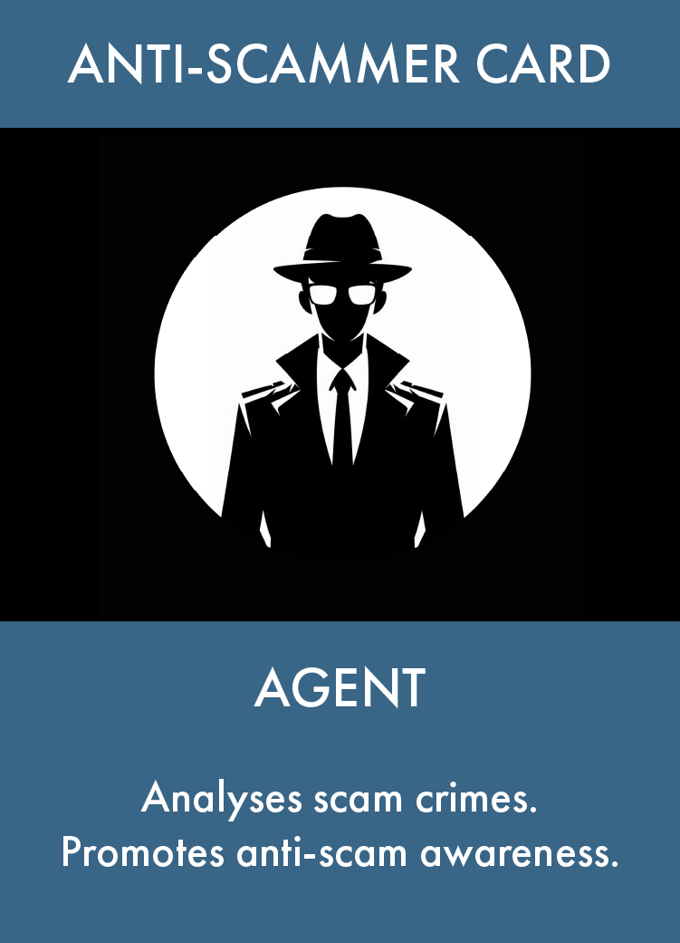
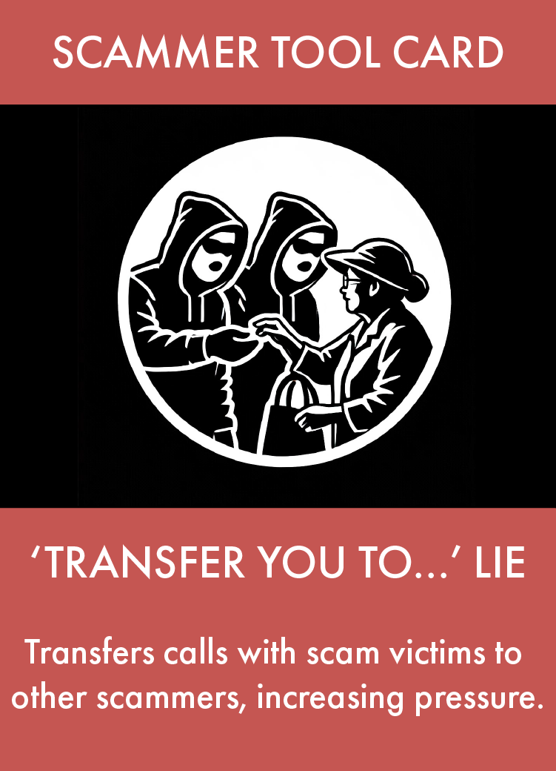
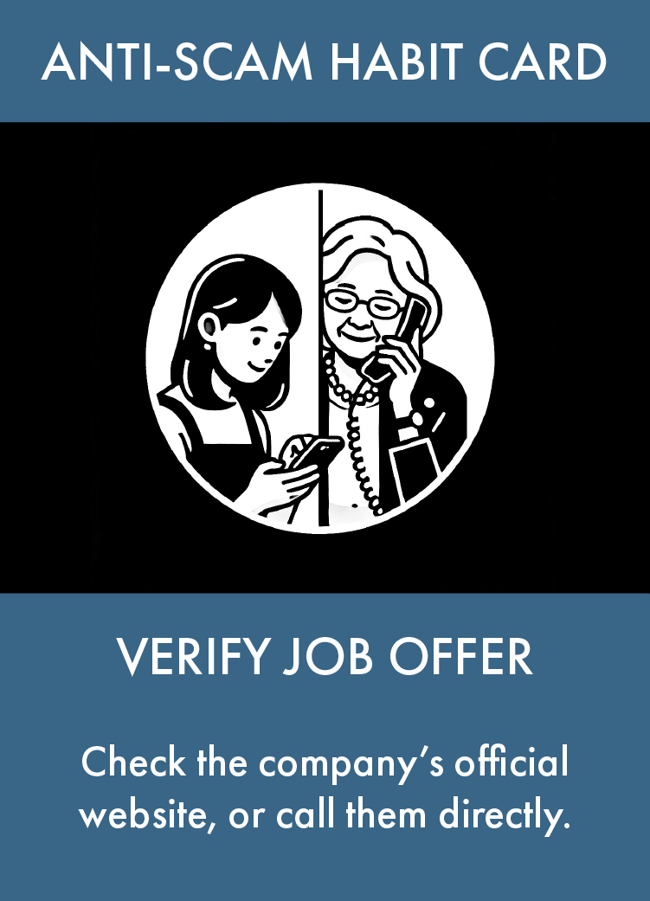



NOW AVAILABLE!
THE ANTI-SCAM
CARD GAME
ADVENTURE

Slide 69

Techniques from today
Engagement techniques
Vibrant images & animation
Group & pair discussions
Self-reflection
Recall mechanics
Breathing exercise
Audience questions
Gamification techniques
Multiple choice Quiz
Yes/No Quiz
Charades
Gamification increases retention by up to 90%
Increases curiosity & lowers defensiveness
Source: Zippia 2023
Image: Pfw-HPB

Slide 70
Techniques from today
Engagement techniques
Vibrant images & animation
Group & pair discussions
Self-reflection
Recall mechanics
Breathing exercise
Audience questions
Gamification techniques
Multiple choice Quiz
Yes/No Quiz
Charades
Adapt to online using
Breakout rooms
Mentimeter
Kahoot
Whiteboard

Slide 71
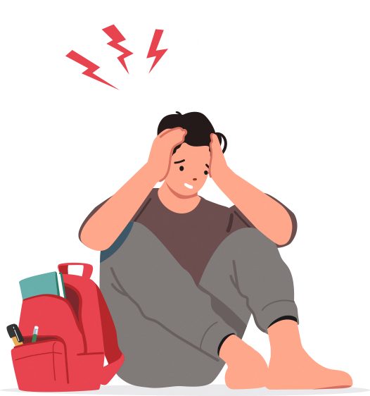

Expect the Unexpected
Know your content
More questions & discussions, quiz
Acknowledge, park and respond later
Stay calm, find out the root cause, park for later if unable to resolve
Faulty equipment
Disengaged audience
Difficult question
Disruptive participant
Image: Pfw-HPB

Slide 72
Group Activity
1) Choose a topic
2) Design a game-based activity to support your audience:
Topic 1: Online safety
Topic 2: Digital wellness
Remember the 3As
AUDIENCE: Who, What, Why
AMBIENCE: Date, Time, Venue
ARSENAL: Information, Engagement, Gamification
Notes:
Split the room to 2 sides and assign each side a topic
Pick a few groups to share.

Slide 73




Digital Parenting Resource Hub
Resources Available
Trainer Support
Request a trainer for your next session
ScamShield website
BB slides resources
Community Chat
MOE Screentime guide
Join WhatsApp group for ongoing support
Workshop templates
Gamification toolkit
Scan for Access
One-stop resource collection
Notes:
BB to present

Slide 74





Thank You & Next Steps
Complete Feedback Form
Schedule Your Session
Share your workshop experience
Plan your first gamified workshop
Join Support Community
Collect Certificate
Connect with other parent trainers
Recognize your new skills
Notes:
BB to present

